Slide 1
APS FAILURE AT SCANIA TRUCKS
submitted by : prince francis

Slide 2
Objective:
Development of a predictive model for faults related to air pressure sensor in the scania trucks.
Benefits
Reduce the effective overall maintenance cost of the trucks by predicting the faults due to air pressure sensor.
Data Sharing Agreement:
Sample File Name(aps_failure_training_set1.csv)
Length of Date Stamp(8 digits)
Length of Time Stamp(6 digits)
Number of Columns
Column names
Column data type

Slide 3
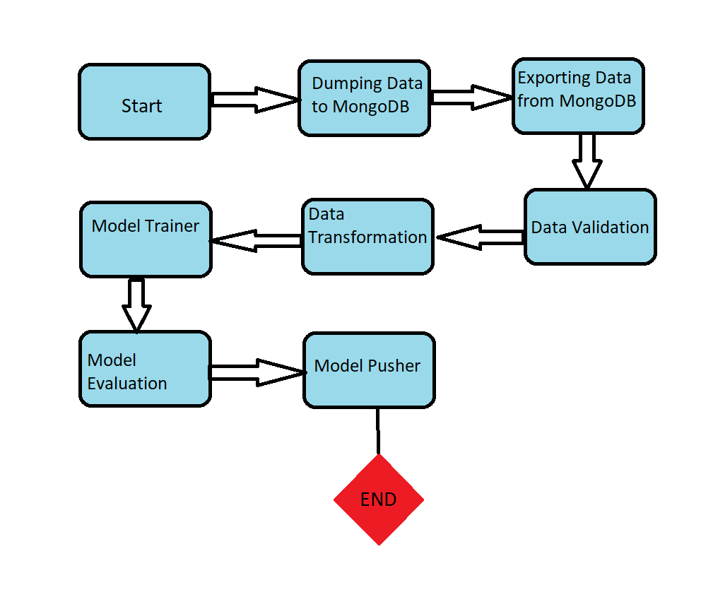
architecture

Slide 4
Data ingestion
Dataframe is being read from MongoDB. The retrieved dataset is being split into two parts i.e Train and Test set.
A folder known as artifact has been created. This is to store files and objects which is corresponding to each component.
Note: Each time the training pipeline is initiated it is being stored under a timestamp in the artifact folder.
Inside the timestamp data_ingestion folder is created. The complete dataset is being stored under subfolder feature_store and the split datasets are being stored under a different subfolder named datasets.

Slide 5
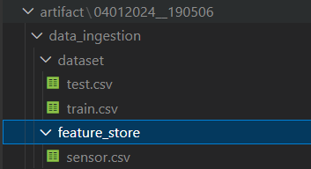
Data Ingestion(cont…)
Below represents the folder directory structure for the data_ingestion folder.

Slide 6
Data validation
In case of data validation we have set a threshold to drop the columns with null values above that threshold.
Then we are setting the complete train dataset as our base dataset.
This is to check if all the columns that are being present in the base dataset are also being there in the current dataset.
After that data drift is being initiated. This is being done using the ks_2samp. Data drift is to check if the distribution is equal for each column. This is done by comparing each column under the base dataset and against the same column in the split train and test dataset.
Finally the results of each operation is being printed in report.yaml file under the directory data_validation.

Slide 7
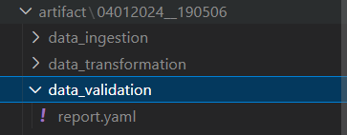
Data validation(contd..)
Below represents the folder directory structure for the data_validation folder

Slide 8
Data transformation
Data is being read from the feature store directory.
A labelencoder is used to convert the output variable.
Using simple_imputer to inpute missing values and also using Robust scaler.
Using SMOTETomek link to handle the class imbalance.
Different components are being stored as follows:
target_encoder → Labelencoder used to convert output column.
transformed→Resampled data after handling class imbalance is stored as test.npz and train.npz
transformer → this is the simple imputer and the Robust scaler all under one hood.

Slide 9
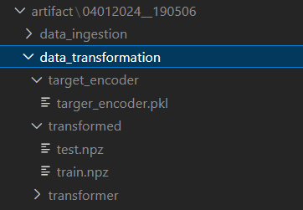
Data transformation(contd….)
Below represents the folder directory structure for the data_transformation folder

Slide 10
Model trainer
Since the data is being transformed we can now train the model.
We have chosen XGBoost classifier inorder to train the data.The model has been chosen after the evaluation of different classification models.
Firstly we are checking if the model is overfitting or underfitting.
The improved model object is being stored under the folder model_trainer.

Slide 11
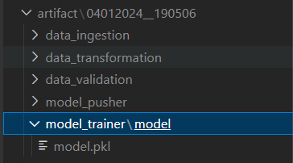
Model trainer(contd….)
Below represents the folder directory structure for the model_trainer folder.

Slide 12
Model evaluation
The main aim of this component is to check first if there is a folder named as saved_folders.
If yes, then we have to load all the model, target_encoder and transformer objects from the latest folder available and check if the current model is performing better than the previous model or not. If yes, then only we will be pushing the current model components as an improved model.

Slide 13
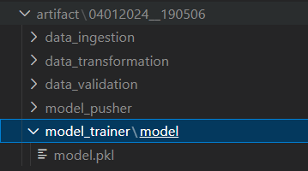
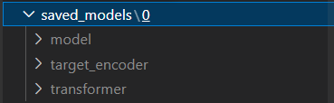
model pusher
If our current model is better than the previous model then we would be pushing the current model components to the folder saved_models.
The same components are also being pushed to the folder model_pusher under the subfolders model, target_encoder and transformer.
Below figures represent the folder structure.

Slide 14

Batch prediction
The dataset on which batch prediction has to be done is aps_failure_training_set1.csv.
The output will be saved in prediction with timestamp.
Below folders represent the folder structures.

Slide 15
Q&A
Q1)What’s the source of the data?
The data for training is provided by the client in multiple batches and each batch contain multiple files.
Q2)What was the type of data?
The data was all numerical values.
Q3)What’s the complete flow you followed in this project?
Refer Slide 3rd for better understanding.
Q4)How logs are managed?
We have created a separate logger.py file to manage log files. Logs are being stored in a separate folder named logs.

Slide 16
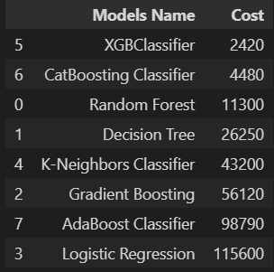
Q&A(contd…)
Q5) What models were being used before choosing one for training?
Q6) What are the different stages of deployment?
Once the project is being pushed on to github CI/CD cycle starts. Once on successful completion
Docker image is being pushed to aws ECR. Then, using the Apache airflow we can trigger the dags for training pipeline and batch prediction.

